Slide 1

Functional Ionic Liquids for Solvent Sensing
Alexandru Tudor, Adam McColgan, Colm Delany, Larisa Florea, Dermot Diamond

Slide 2
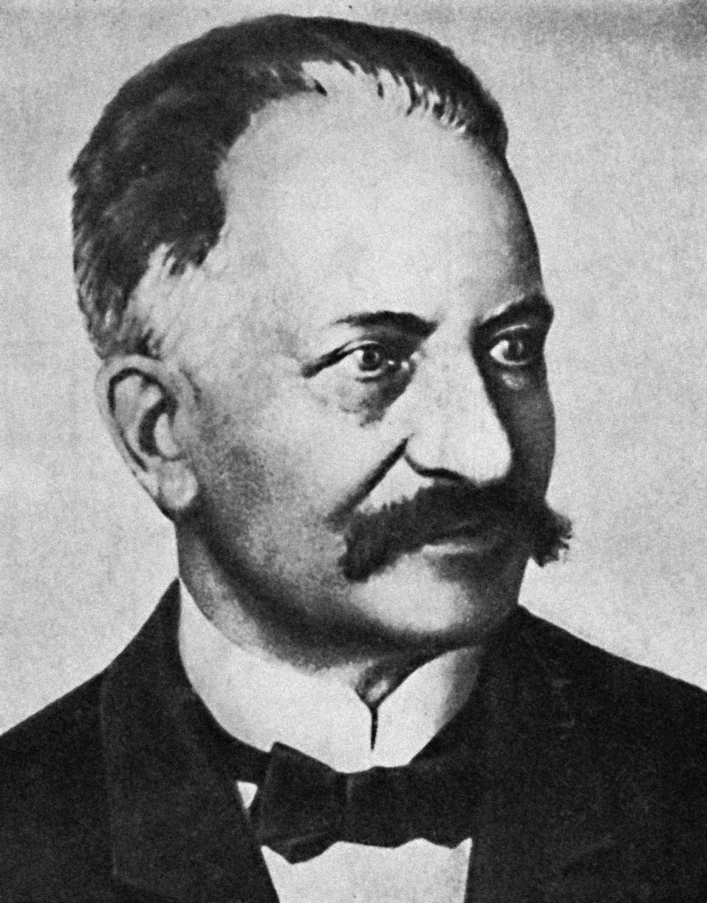
The Origin of Ionic Liquids
1914
1992
Ethylammonium Nitrate
1-methyl-3-ethyl imidazolium
Paul Walden (1863-1957)

Slide 3
Ionic Liquids
Common cations
+
Common anions
-

Slide 4
Ionic Liquid Monomers
Cationic
+
Anionic
-

Slide 5
Fluorescein

Slide 6
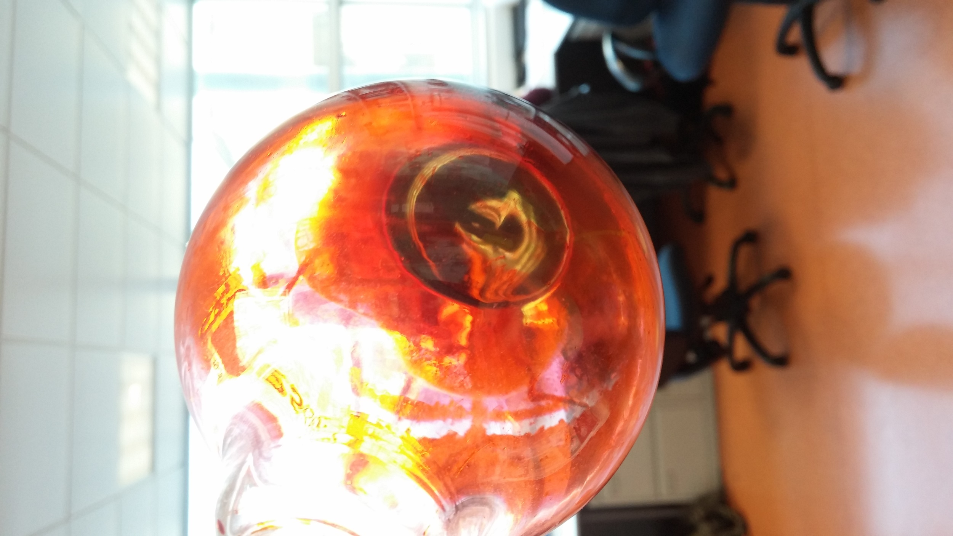
Fluorescein-based Ionic Liquid
Trihexyltetradecyl Phosphonium Fluorescein

Slide 7
Crosslinked Poly(Ionic liquid)s Ionogels
Monomer
Ionic Liquid
Tetrabutyl Phosphonium Sulfopropyl Methacrylate (P₄₄₄₄-SPMA)
Crosslinker
Polypropylene Glycol Diacrylate
Trihexyltetradecyl Phosphonium Fluorescein (PFl)

Slide 8
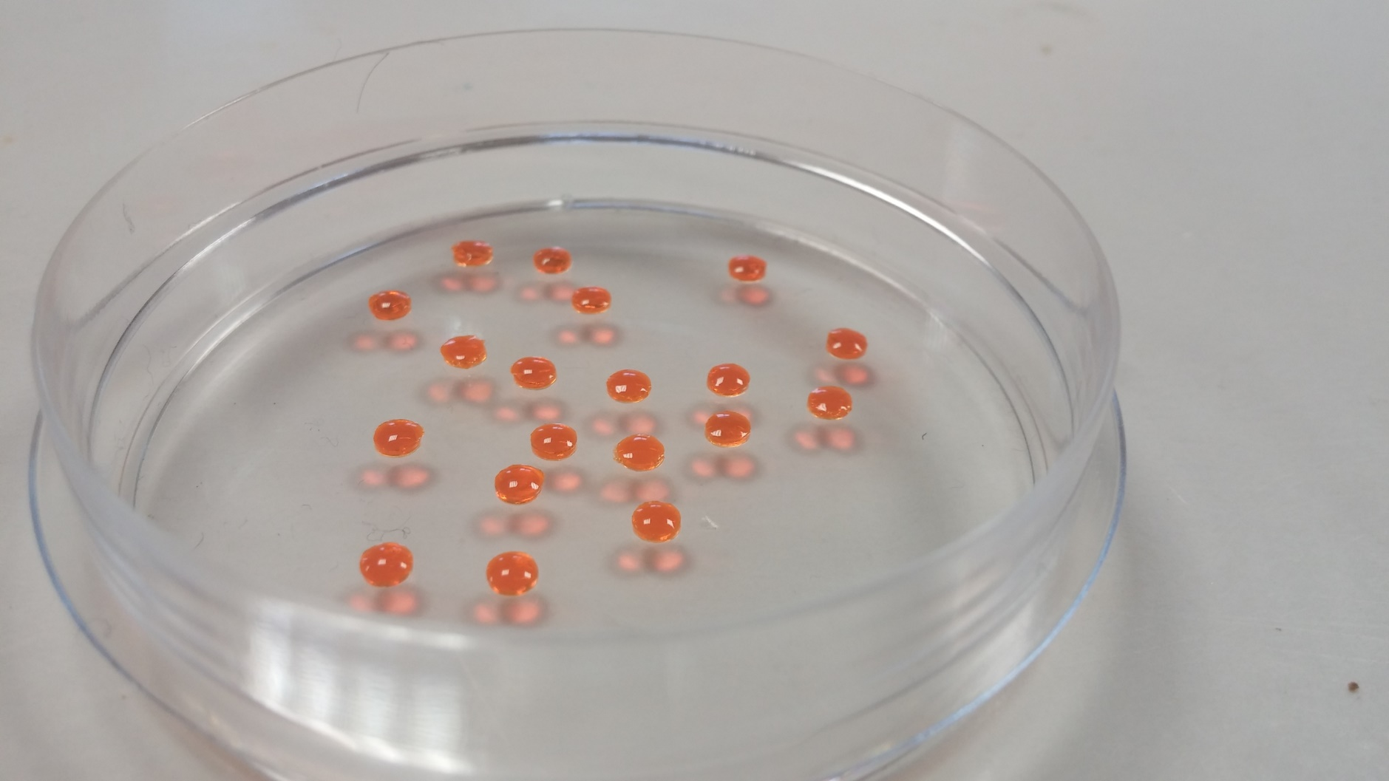
Poly (Ionic Liquid) Fluorescent Ionogels
P₄₄₄₄-SPMA and PFl
Photoinitiator
H₂O + Methanol
5 %_{m} Crosslinker
3.5 mW·cm⁻²
for 30min
1 mm
3 mm

Slide 9
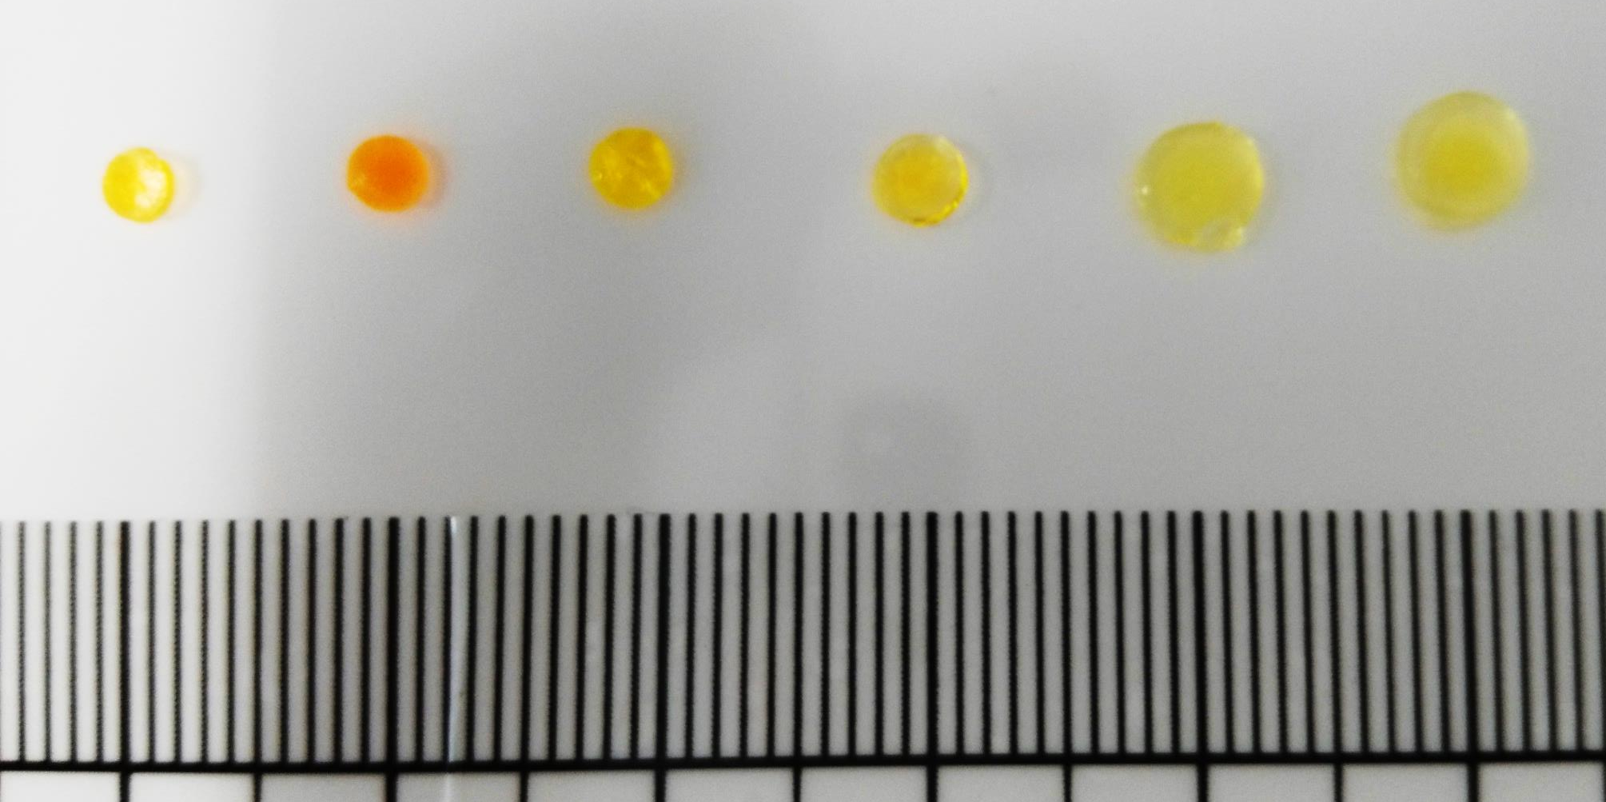
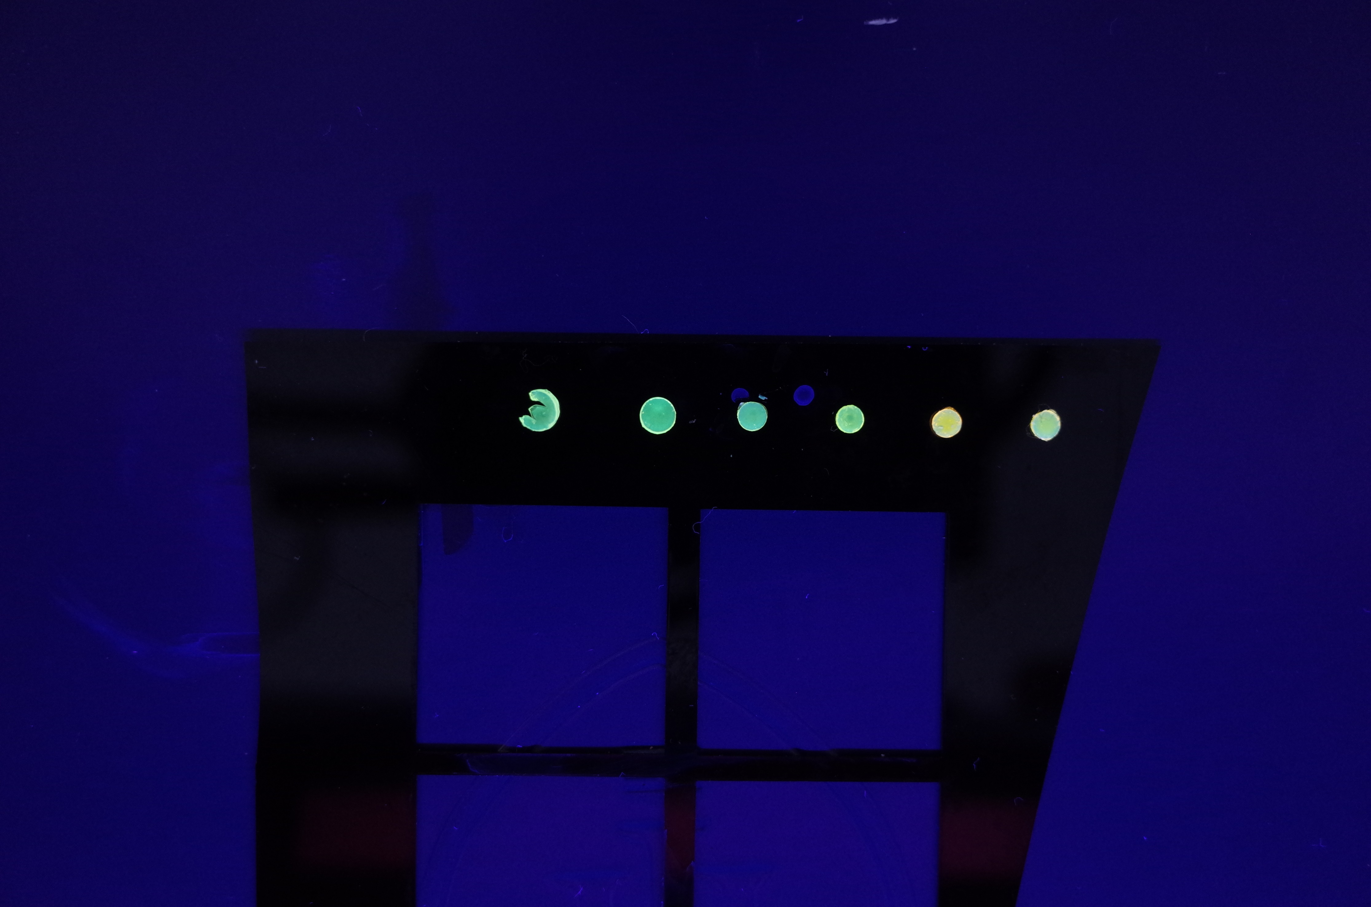
Ionogel Swelling
Hexane
Toluene
Acetone
Dichloromethane
Methanol
Acetonitrile

Slide 10
Fluorescence Spectroscopy

Slide 11
Fluorescence Spectroscopy

Slide 12
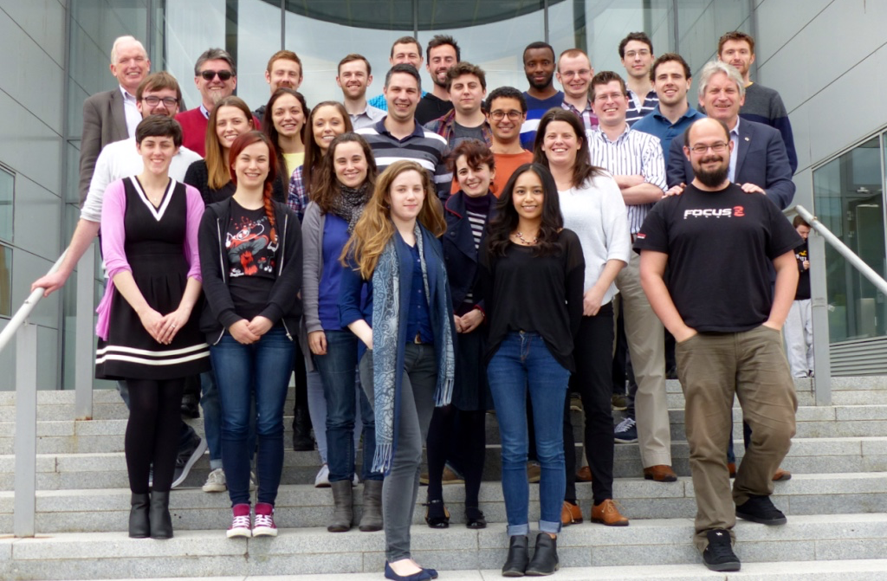




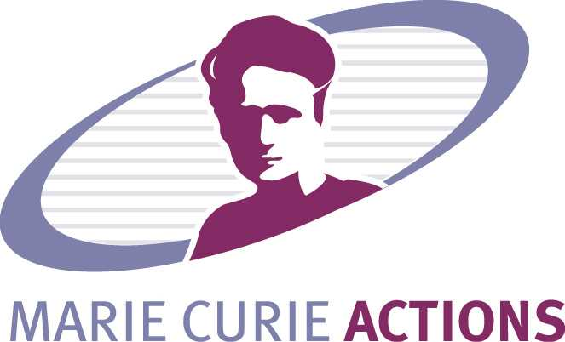





Acknowledgements
Dr. Larisa Florea, Dr. Simon Gallagher, Dr. Simon Coleman, Dr. Colm Delaney.
Conor O’Quigley, Tom Glennon.
Wayne Francis, Aishling Dunne, Danielle Bruen, Jennifer Deignan.
Adam McColgan.
Prof. Dermot Diamond.
Marie Curie ITN FP7 OrgBIO project.

Slide 13
Conclusions
A fluorescein ionic liquid was synthesized
A solvatochromic ionogel was synthesised and it had its solvent response characterized
Future Work
Synthesise ionogels containing different dissolved functional organic compounds and ionic liquids such as boronic acid derivatives for glucose sensing
  Enlarge the ionic liquid and ionic liquid monomer toolbox

Slide 14
UV-Vis Spectrophotometry

Slide 15
UV-Vis Spectrophotometry

Slide 16
Fluorescence Spectroscopy

Slide 17
Fluorescence Spectroscopy

Slide 18
Acid-Base Equilibrium of Fluorescein

Slide 19
Poly(Ionic Liquid)s
+
+
+
+
-
-
-
-
PFl
PFl
PFl
-
-
-
-
+
+
+
+

