Slide 1
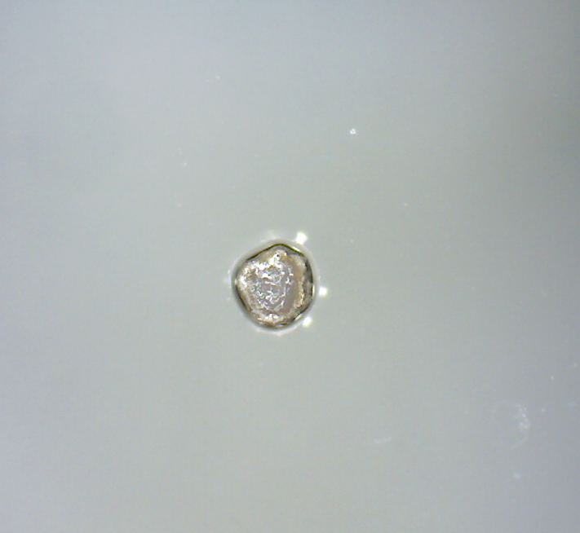
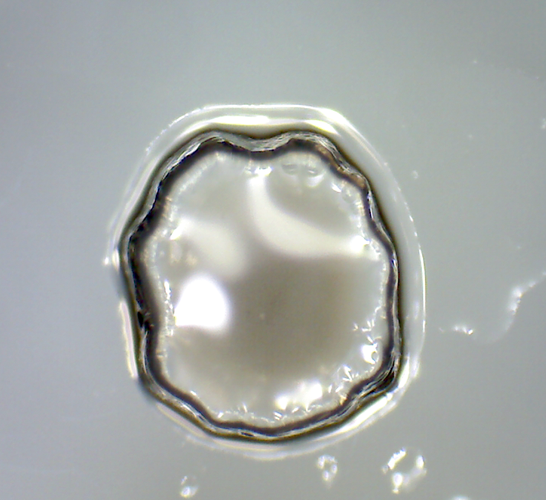
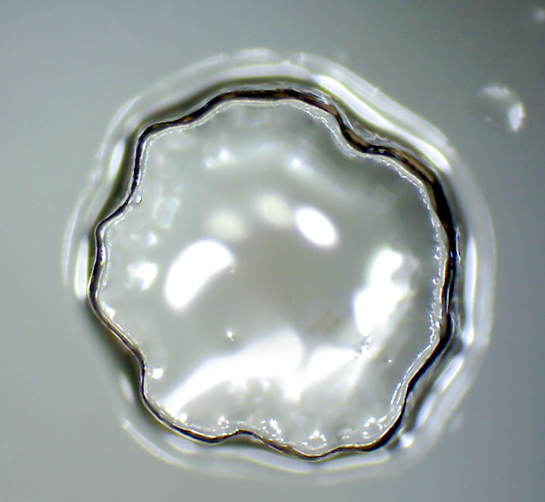

    Stimuli-responsive hydrogels based on acrylic acid and acrylamide
Aishling C.M. Dunne, Siobhán Mac Ardle, Larisa Florea*
and Dermot Diamond
Dublin City University, School of Chemical Sciences, Insight Centre For Data Analytics, National Centre For Sensor Research, Dublin, Ireland
Introduction
From pH to photo-response
Hydrogels are three-dimensional polymeric networks that can absorb and retain large quantities of water in relation to their physical size. By incorporating stimuli-responsive units into the gel structure, hydrogels can be actuated by external stimuli such as photo, thermal, electro and pH, among others.
In this study, pH responsive hydrogels were developed using copolymers of acrylic acid (AA) and acrylamide (Am) in different molar ratios (30:70, 50:50 and 70:30, respectively).
Spiropyran acrylate (SP-A) was copolymerised in the polymer backbone as a photo-acid generator.
Spontaneous in H₂O
White Light
pH responsive hydrogels
Less hydrophilic
More hydrophilic
Above pH 4.5
When the hydrogel is immersed in water, in the dark, the AA dissociates and the proton is taken by the SP-A to form protonated merocyanine (MC-H⁺)(yellow) resulting in hydrogel expansion. When exposed to white light, the MC-H⁺ is converted back to SP-A (colourless) and some of A⁻ gets reprotonated to AA resulting in hydrogel contraction.
Below pH 4.5
At pH above the pK_{a} of AA (pK_{a}~ 4.5) the AA dissociates to the more hydrophilic acrylate (A⁻) form triggering swelling of the hydrogel. In contrast, at pH < 4.5, the hydrogel contracts due to the formation of the less hydrophilic AA form in the polymer backbone, which triggers release of water from the gel.
Photo-responsive hydrogels
The optimal composition used for the photo-responsive hydrogel was AA: Am: SP-A in a 10:10:1 molar ratio.
White
light
White
light
White
light
A⁻
(50%)
AA
(50%)
A⁻
(50%)
DARK
DARK
DARK
AA
(100%)
The photo-actuation process is reversible, with the initial photo-contraction completed in about 120s and remaining at a constant value as long as the white light is turned ON (10 mins). After the white light is switched OFF the hydrogel reswells to approximately its fully hydrated size in the first 60s in the dark and its size remains relatively constant until the next irradiation cycle. This process was repeated at least 3 times with no detectable hysteresis.
500μm
500μm
500μm
Conclusions
pH responsive hydrogels based on p(AA-Am) have been developed with significant shrinking/swelling capabilities. Introduction of a photo-acid generator, namely SP-A, inside the polymer backbone allowed for reversible hydrogel photo-actuation of over 15% in area in less than 2 minutes.
pH 3
pH 5.5
pH 11

