Slide 1
Using Data Analytics to Predict Peer-Group Effects on Student Exam Results
Philip Scanlon & Alan F Smeaton

Slide 2
Agenda
Research question.
Research Area:
Learning Analytics
Groups
Social Network Analysis
Methodology
Conclusions
Notes:
Bases of research
Research Domains:
Learning analytics as an approach to data collection
Understanding Group – formation and influences – dynamics
SNA – tools for analysis of collected data
Methodologies to dealing with the questions

Slide 3
Research Questions
Can we identify the make-up of student social and academic groups from the analysis of a students digital footprint at university?
Does the number of groups a student is a member of, influence the academic performance of the student?
Does the make-up of a group dictate the academic performance of the students in the group?
Notes:
Primary Question Can we identify the make-up of group

Slide 4
Learning Analytics
“learning analytics is about collecting traces that learners leave behind and using those traces to improve learning” (Erik Duval )
Data Sources:
Learning Management Systems (Moodle/Blackboard/Moocs)
Use of University Assets (ICT/Library)
Eduroam (wifi)
Requirement:
Extracting value from learning-related data.
Notes:
Duval (RIP) served on the executive committee of the Society for Learning Analytics Research (SoLAR)
DATA sources – in University environment. Virtual Learning Environment
Mooc Massive Open Online Courses (free online courses)
ICT – PC
Library access/ book rental/ book research
Eduroam - requests

Slide 5
Groups:
“A coming together of individuals for a purposeful experience or satisfy some common goal”. (Jarleth Benson 2009)
Exogenous groups
Formal - Having an external cause or origin.
Endogenous groups
Informal - Having an internal cause or origin.
Requirement.
What groups do students become members of.
Notes:
We will be identifying Groups and looking at their composition and their influence on their members.
Students are initially formed into Exogenous groups by the university administrators.
Classes normally have group assignments and in the early days lecturers put student in groups – RANDOMLY
Endogenously formed groups are those that occur between students because.
Country, county, background???
What Groups – Academic and Social (friends/clubs-socities)

Slide 6
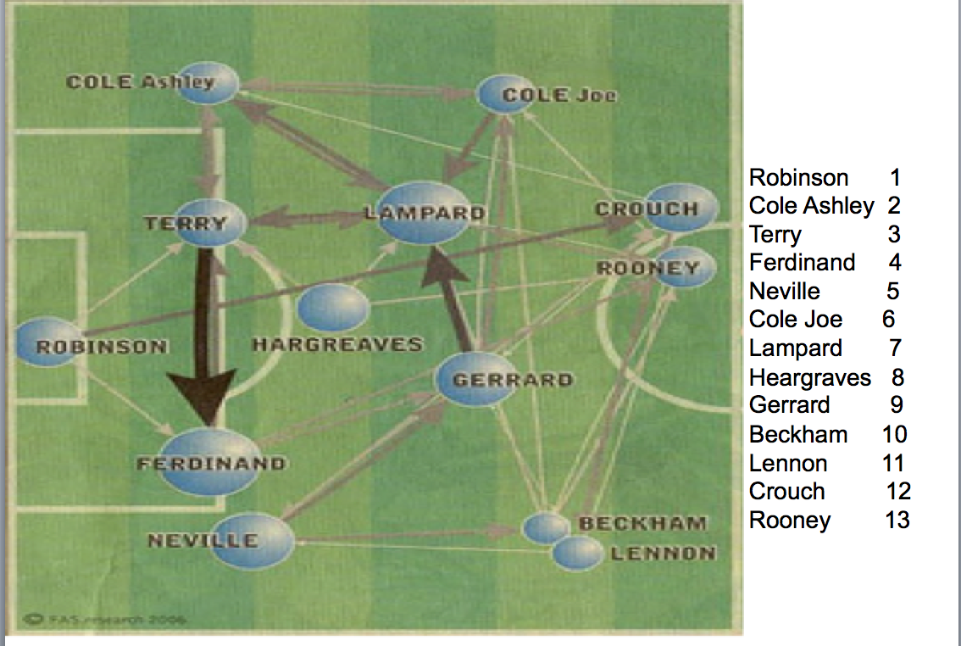
Social Network Analysis
“to identify patterns or regularities of inter-relationships among interacting units.” (Wasserman. 2008)
** **
Notes:
Interaction between members of a group
Any team sport - population or domain
TRIAD - Terry, Lampard and Cole – different interaction than Gerard-Rooney- Beckham
Illustrate interactions and strength of interaction

Slide 7
Data Set
Data:
University Population 12,000
Participating Modules 10
Participating Students 2,028
End of Semester exam results 1,431
Eduroam (education roaming):
Network Access Points points: 780
Number of “Events” per semester 350m
Notes:
Eduroam - available in 76 territories
Event – request for access.
Large drop off rate:
First years
Module changes.
Exams not sat for illness OR other reason

Slide 8
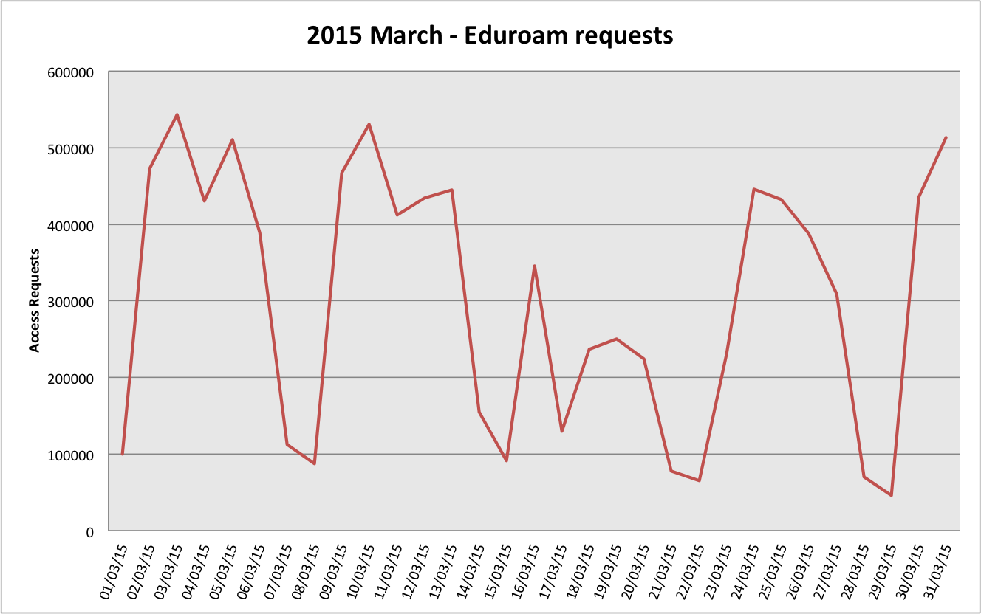
Digital Footprint
Notes:
Nathan Eagles: “Although humans have the potential for relatively random patterns of behavior, there are easily identifiable routines in every person’s life”

Slide 9
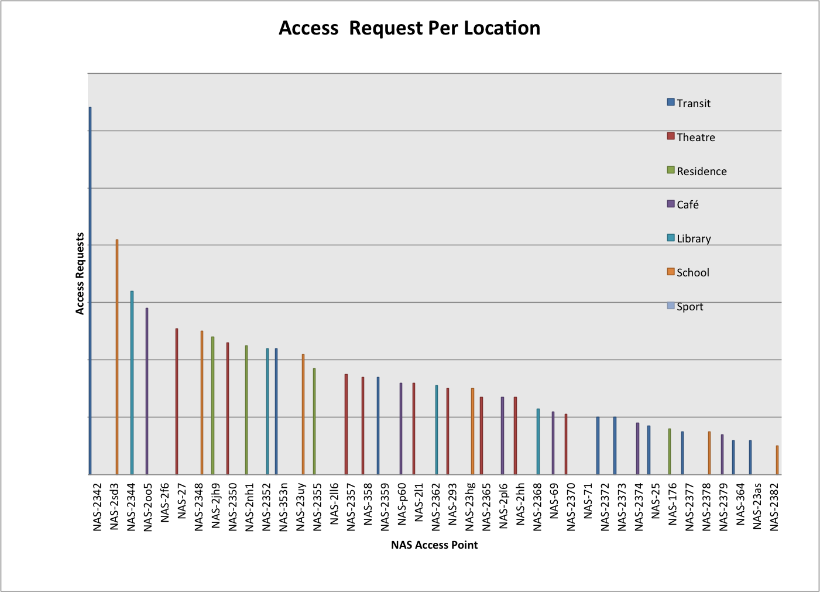
Slice of time - Location
Notes:
Number of OPT_INS people connected to a NAS - Network Access Server.
Popular meeting areas

Slide 10
Methodology
Academic & Social Areas
Subdivision into 7 categorized locations
Academic and Social
Identify groups:
Pairwise Co-location
Pairwise Count
Count of interactions
Notes:
Nathan Eagles: “Although humans have the potential for relatively random patterns of behavior, there are easily identifiable routines in every person’s life”
Pairwise Co-location – identify Two students sharing time and space
Pairwise count: Number of interactions between each pair.

Slide 11
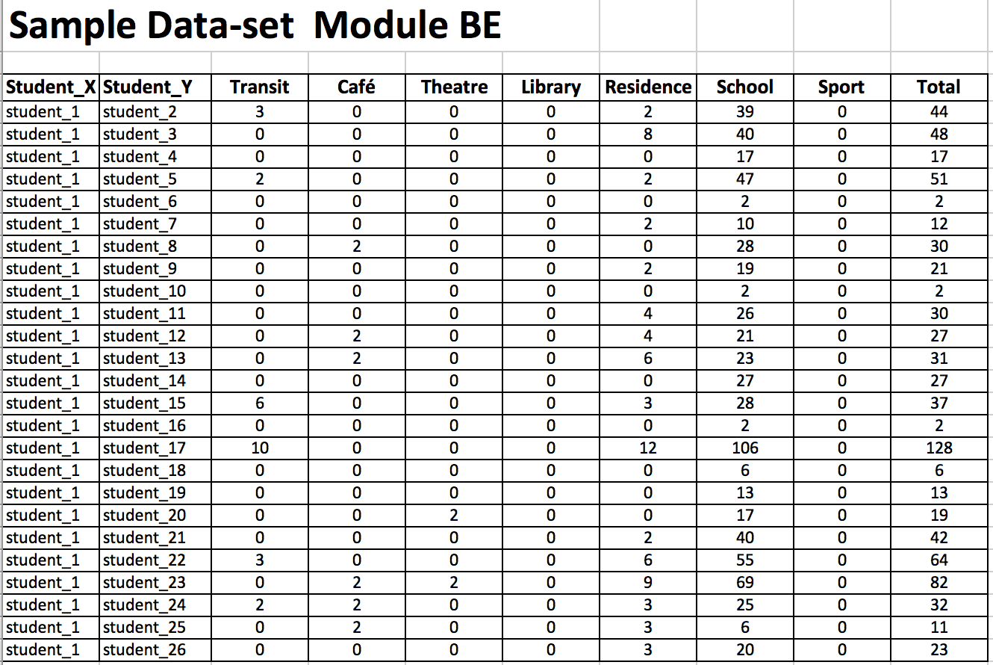
Sample Module BE101 – Introduction to Cell Biology
Notes:
Semester: 1 of 1
Degree of a pair

Slide 12
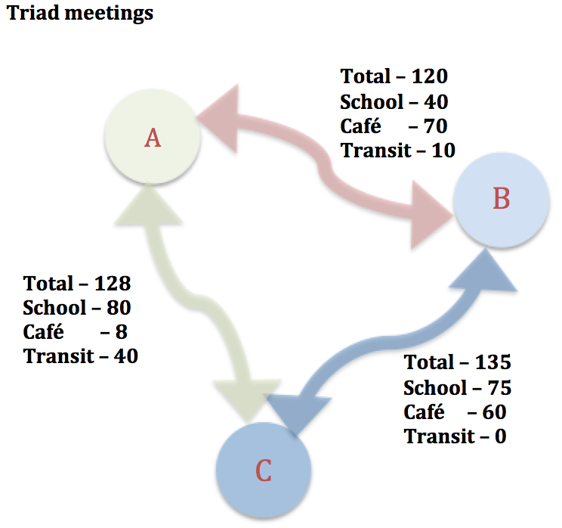
Analysis:
Extract features per student:
Degree of friends.
Degree of interactions per area
Total degree of interactions per category
PageRank score
weighted
Notes:
PageRank - Google uses to determine a page’s relevance or importance based on the number of “Links” & Rank of those nodes
Similar Total scores – features identify different friendship
Example: Terry- Cole-Lampard - same pitch, same team but different patterns of play in different area
SNA focus on the interaction rather than the nodes

Slide 13
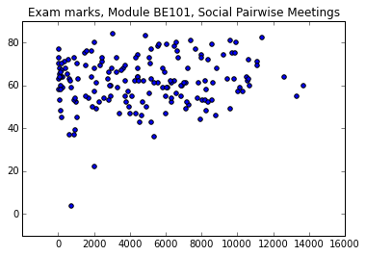
Analysis:
Simple Linear regression.
Pearson
Ordinary Least Square
Machine learning Models:
LinearRegression
KNeighborsRegression
Notes:
Results of approx R2 -> .09 to .19 score for Social and Academic features
First Semester – First Year,
Three weeks before the number of student groups stabilised
Social selection – seeking out similar students? Homophily

Slide 14
Conclusions
Can we identify the make-up of student groups from the analysis of a students digital footprint at university? Yes – Examining pairwise meetings
Does the number of groups, a student is a member of, influence the academic performance of the student? Not conclusive
Does the make-up of a group dictate the academic performance of the students in the group? Requires further research
Notes:
Main conclusion First Semester First Year students MAY still be in a state of group development (Dynamic Network.)
Indications that an academic groups has greater effect than Social numbers.
“Research For Knowledge” Vs “Research with economic returns”…
Environmental planning _ Group size composition – Location of meetings
Course work design – group work

Slide 15
Discussion
This project has been funded by Science Foundation Ireland (SFI) under Grant Number SFI/12/RC/2289

